Slide 1
Controller-Plant model for DC motor

Slide 2
Overview
What is controller-plant model
Implementation of plant model
PID Controller
How to control a DC motor
Torque control DC motor
Speed control DC motor

Slide 3
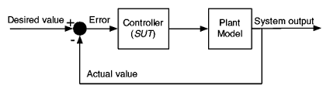
1.What is controller – plant model

Slide 4
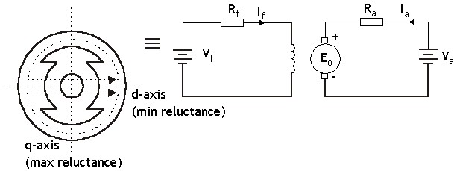
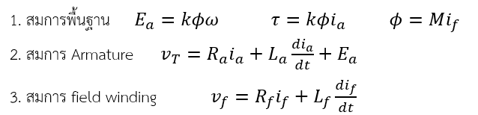
2.Understanding the system

Slide 5
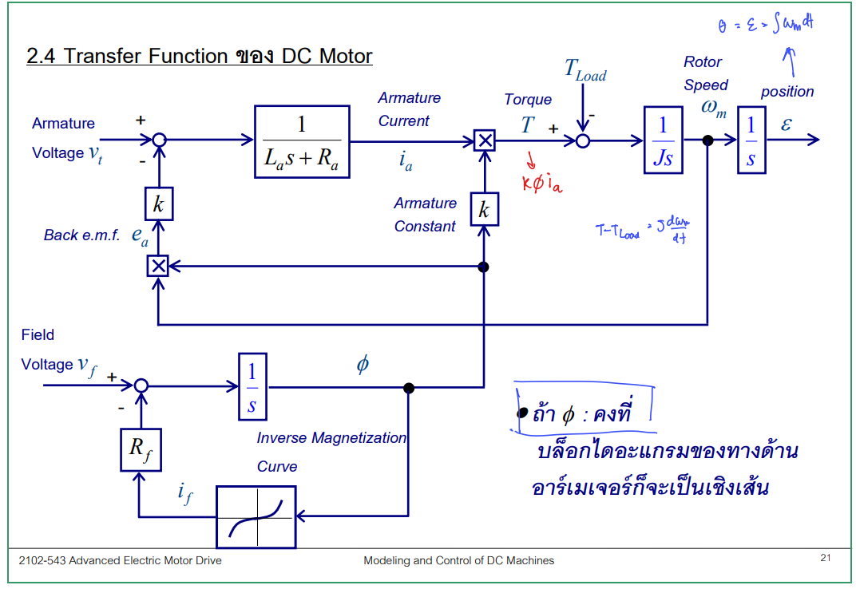
input
output

Slide 6
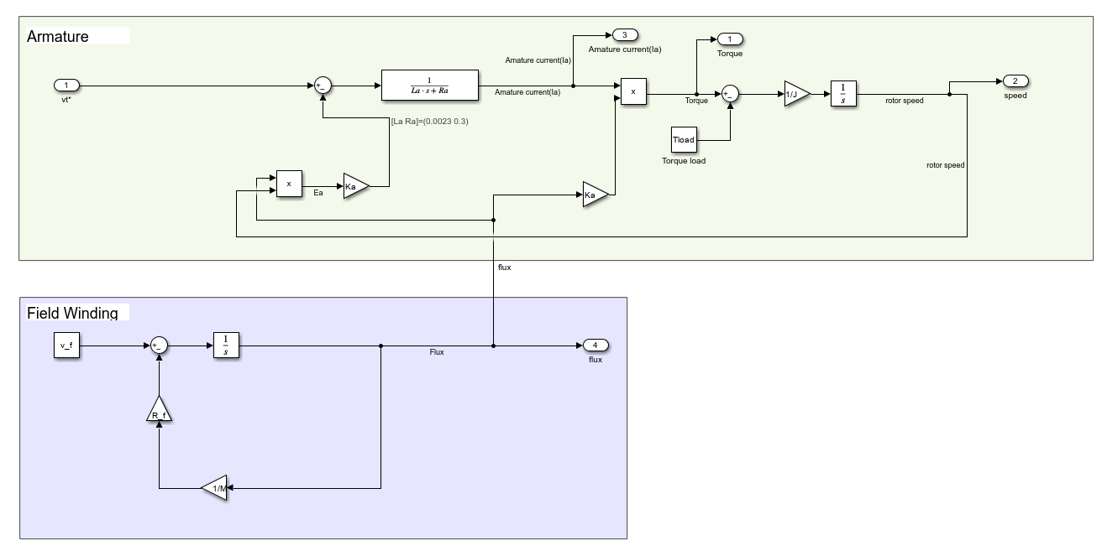
Plant model

Slide 7
We need a controller to control the output

Slide 8
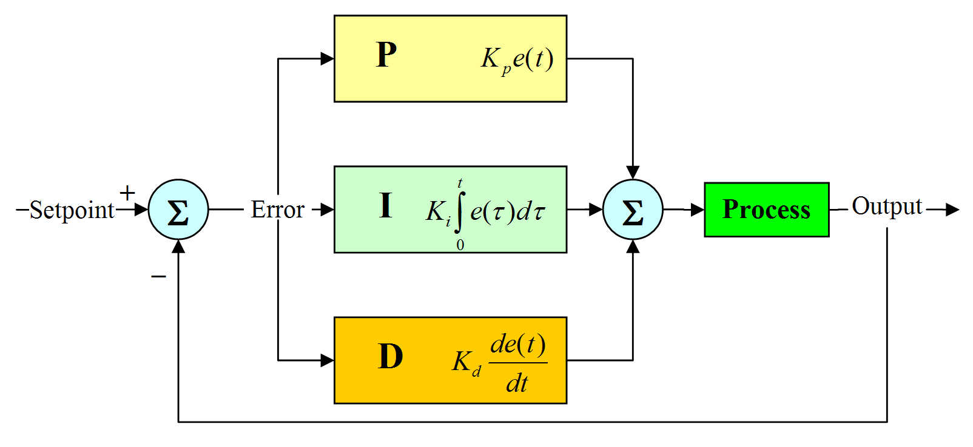
3.PID controller
Proportional
Integral
Derivative

Slide 9
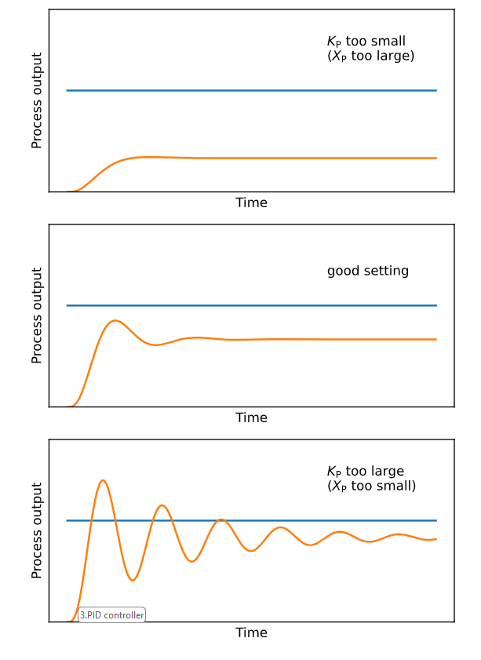
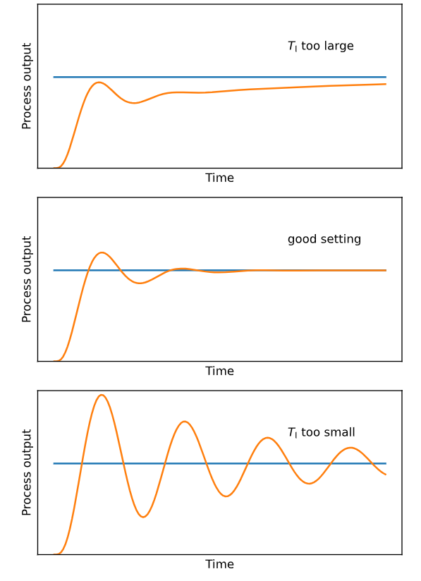
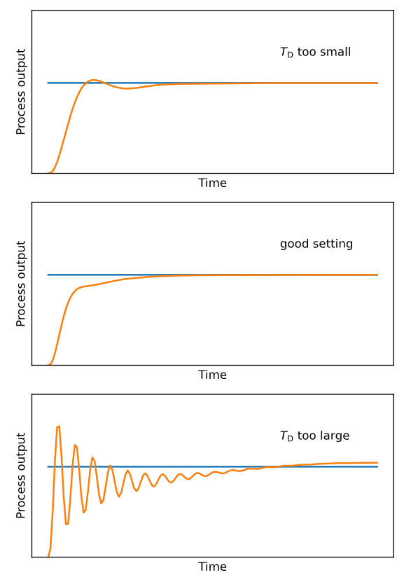
3.PID controller
Proportional
Integral
Derivative

Slide 10
4. How to control a DC motor
Output : Torque
input
output
Input : Vt
Output : Rotor Speed
Output : Position

Slide 11
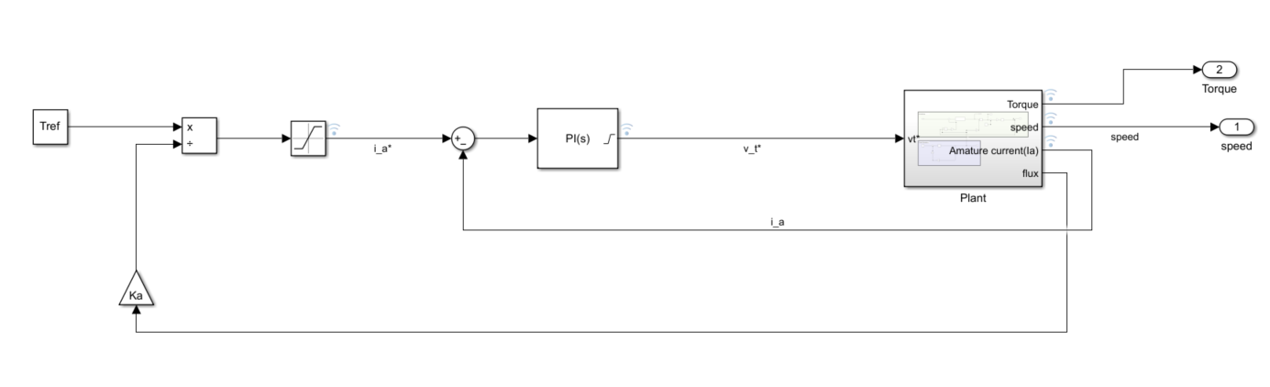




5.Torque control
Aim for the steady-state :
$τ_{load}=$ $τ_{ref}$
$$τ=kφi_{a}$$
$$v_{T}$$
Controls
$K_{P}$ = 1.5 และ $K_{I}$= 550

Slide 12
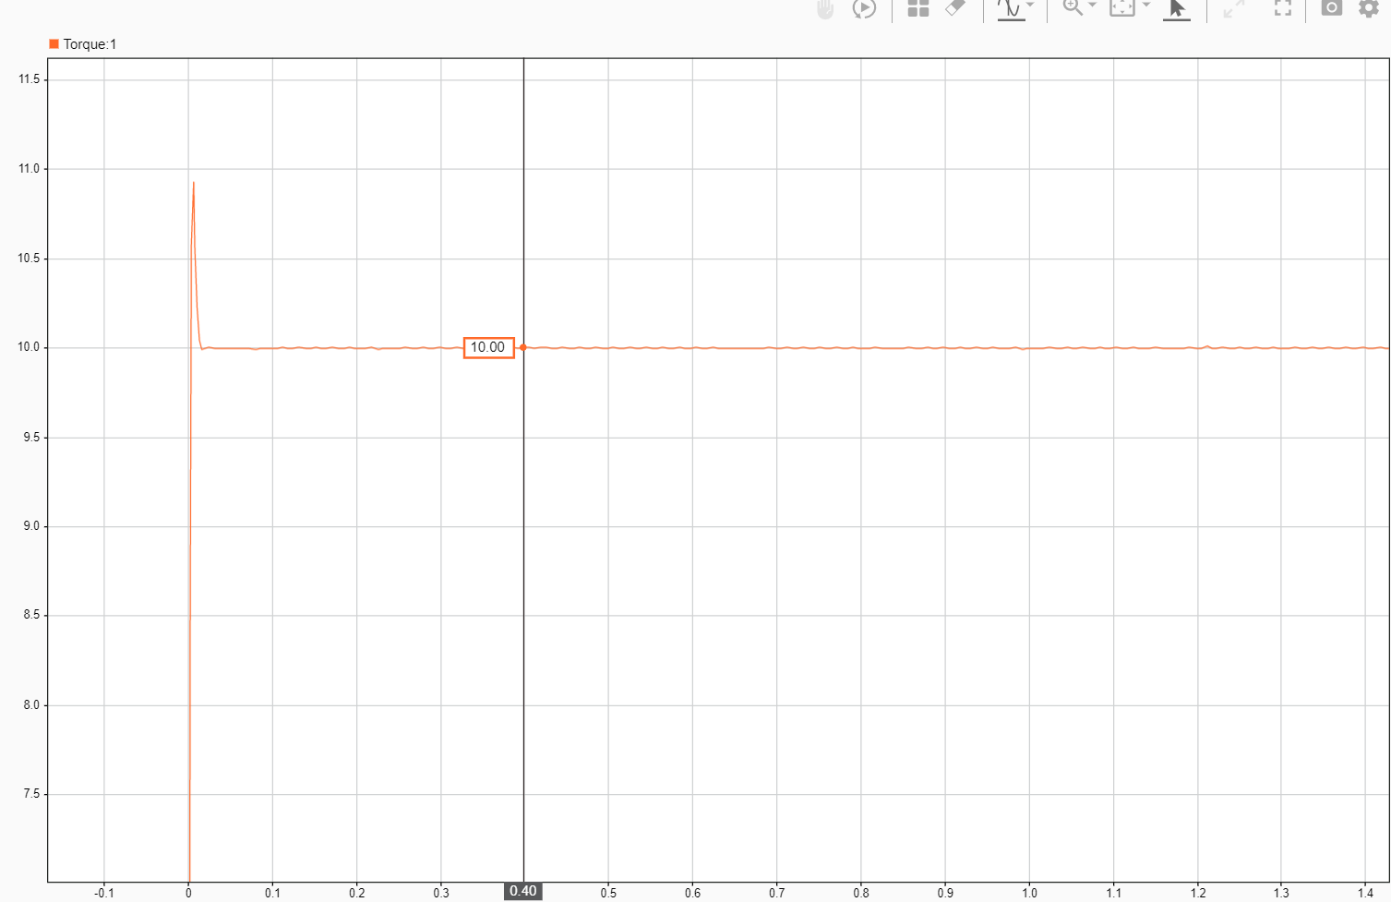
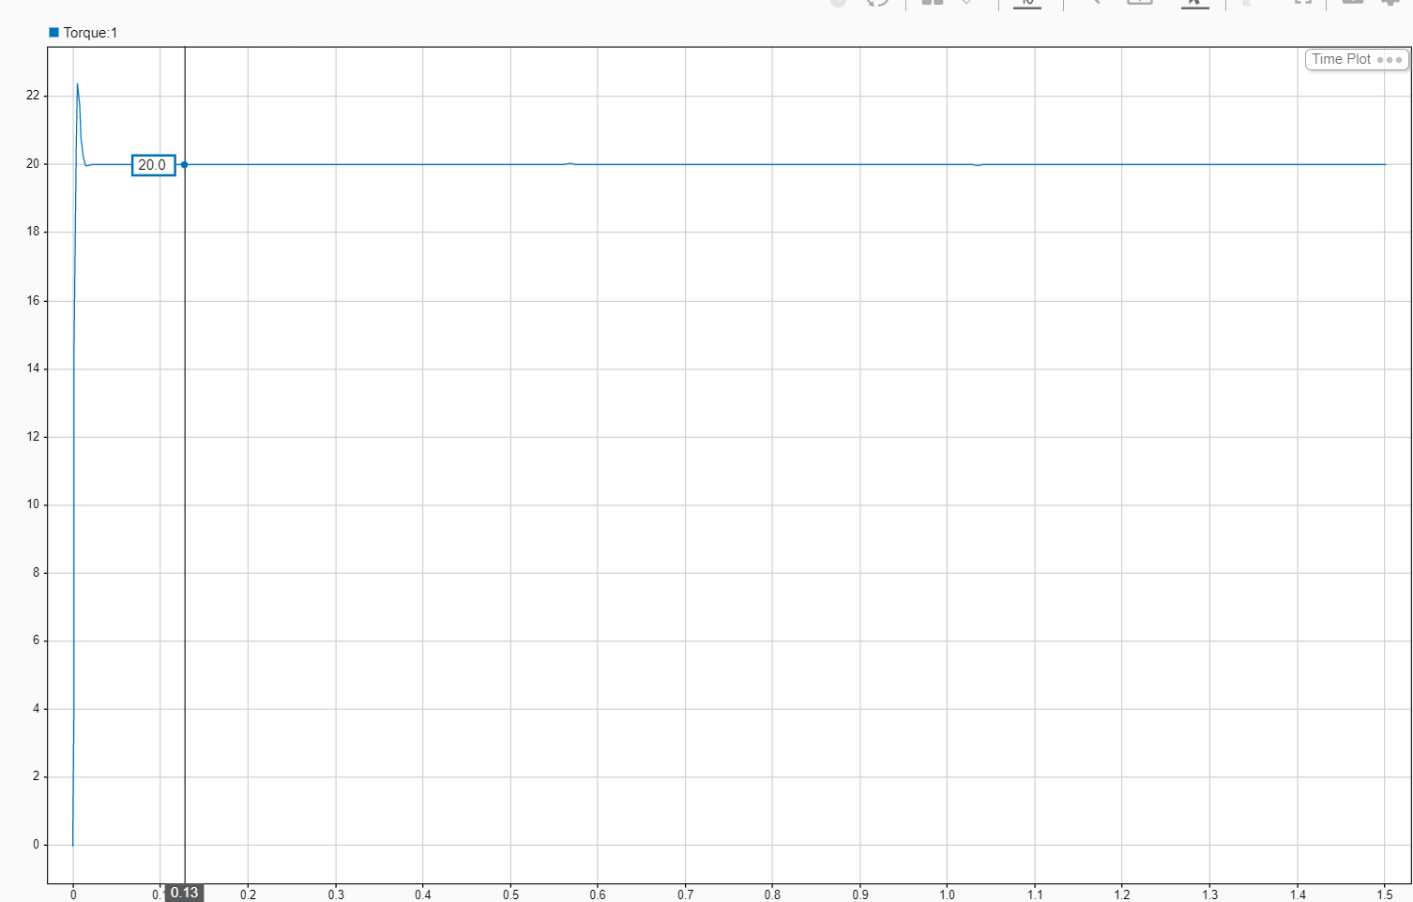


5.Torque control
$τ_{load}=$ $τ_{ref}=10 N∗m$
$τ_{load}=$ $τ_{ref}=20 N∗m$

Slide 13
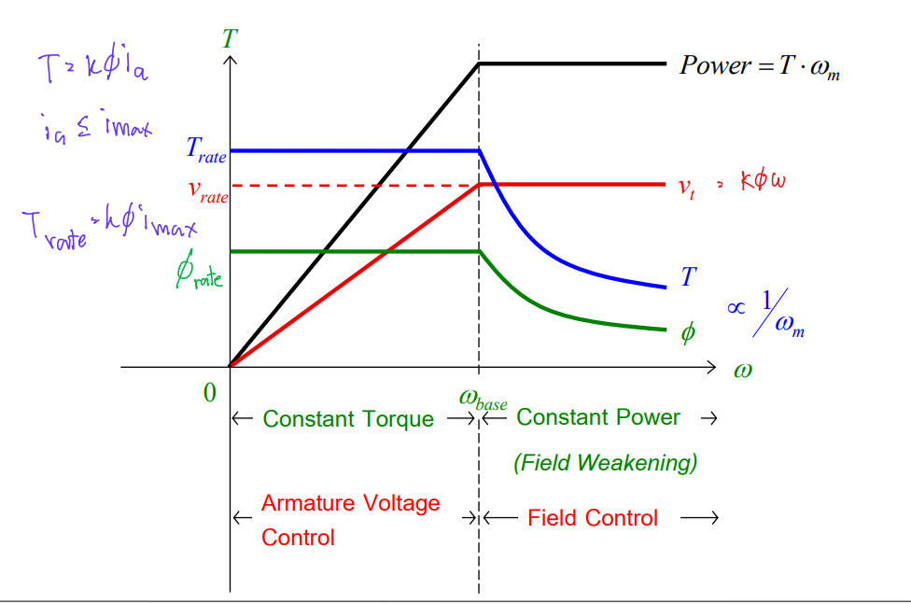
6.speed control

Slide 14
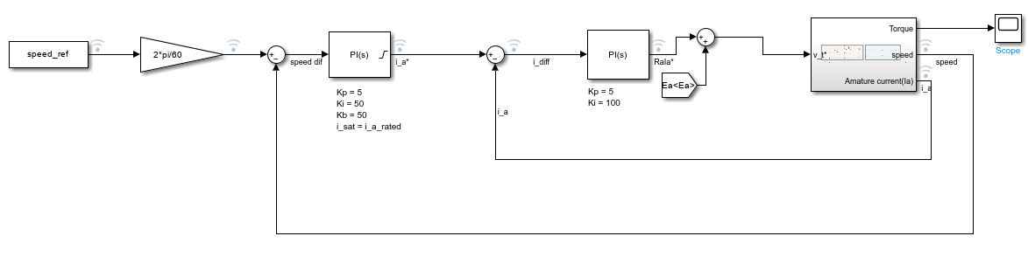
Controller model
Speed*
i_a*
V_t*

Slide 15
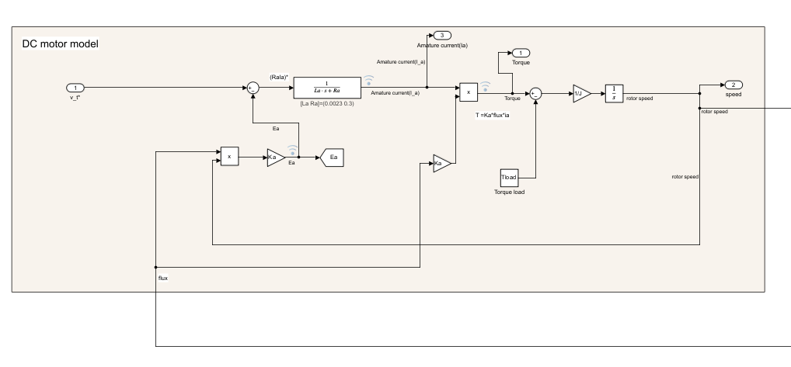
Plant model – DC motor

Slide 16
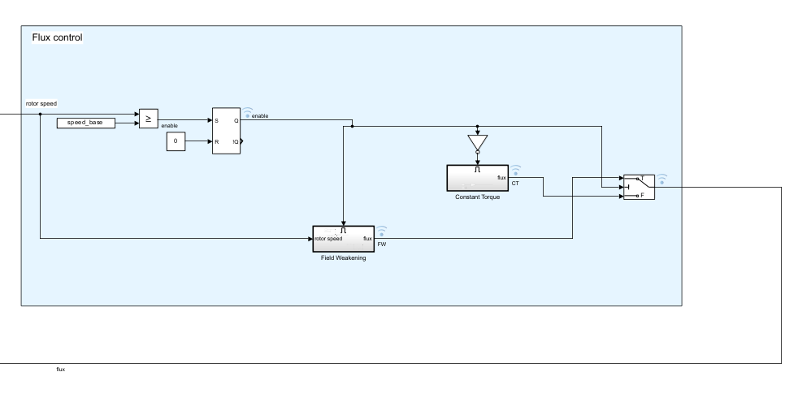
Plant model – flux control
Speed_base = 2500rpm

Slide 17
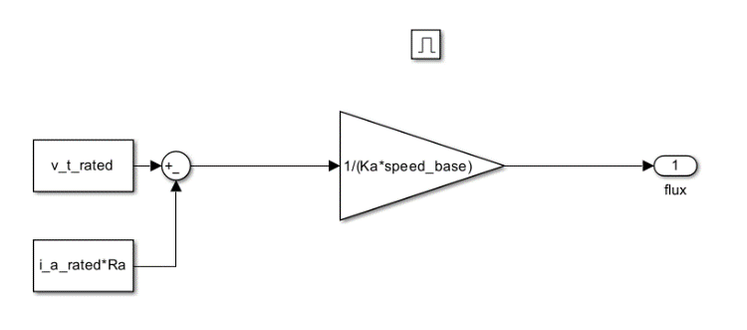
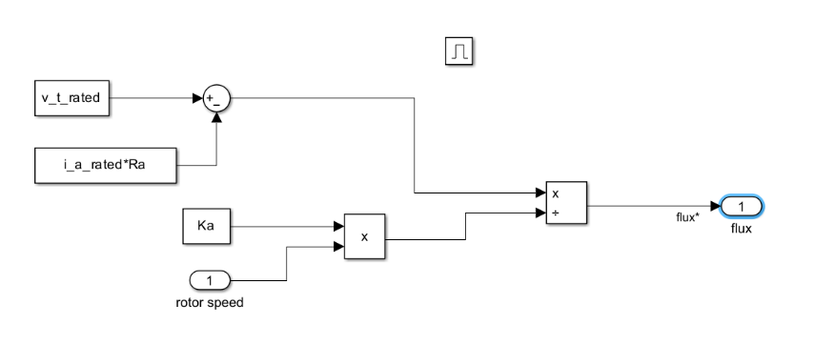
Constant Torque state
Field Weakening state

Slide 18
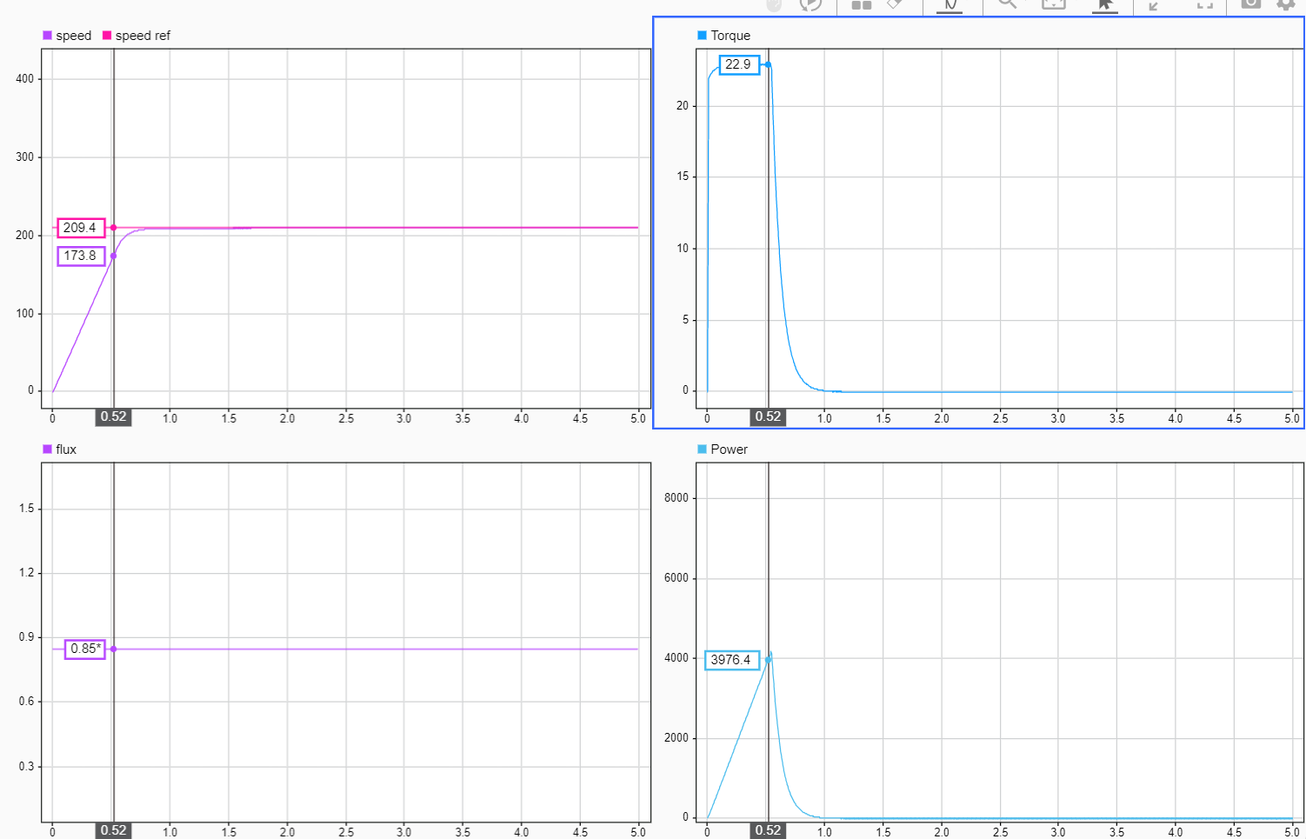


$ω_{ref}$ = 2000 rpm = 209.4 rad/s
Constant Torque state
$ω_{base}$ = 2500 rpm = 261.7994 rad/s

Slide 19
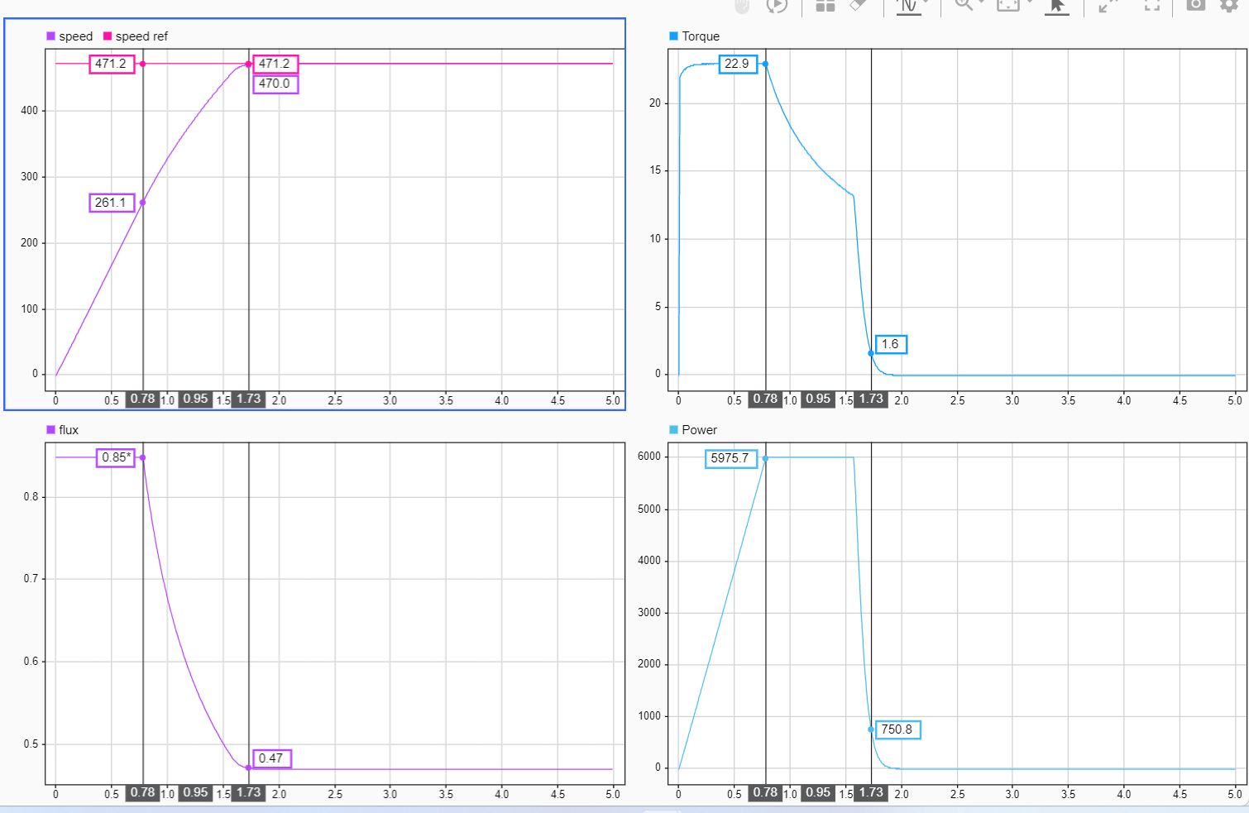


Constant Torque state
$ω_{ref}$ = 4500 rpm = 471.2389 rad/s
+
$ω_{base}$ = 2500 rpm = 261.7994 rad/s
Field Weakening state
1
2
3
1
2
3
Constant Torque
Field weakening
Steady state
1
2
3
1
2
3

Slide 20
Conclusion
Relationship between each parameters
Plant model
Understanding the system
Input & output
Control signal
PID tuning

